Slide 1
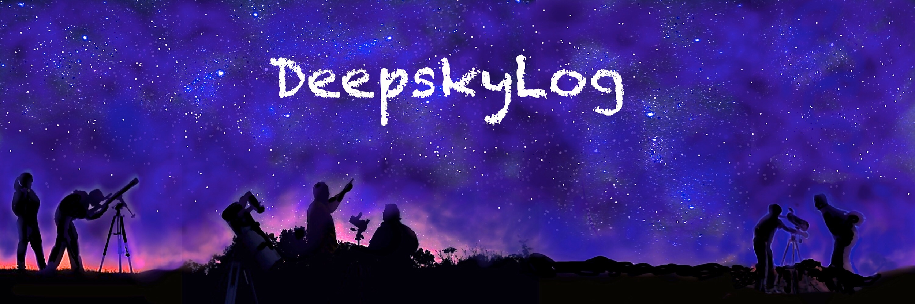
DeepskyLog 5.0
What to expect

Slide 2
New Layout
Bootstrap
Responsive
Easy to use framework
TableSorter
Sorting
Sorting on multiple columns
Movable columns

Slide 3
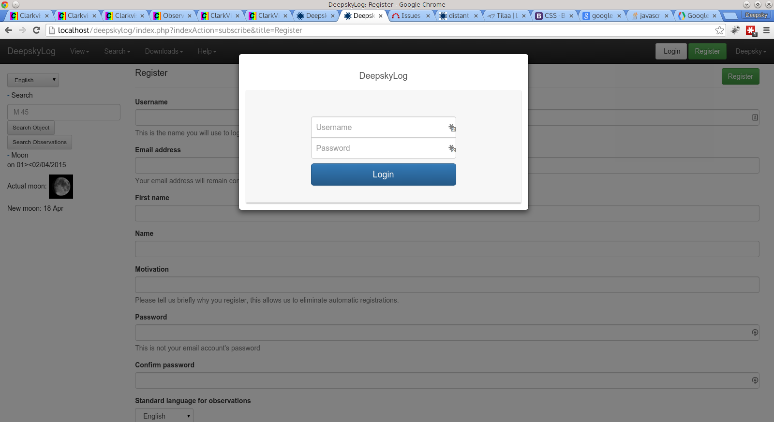

Slide 4
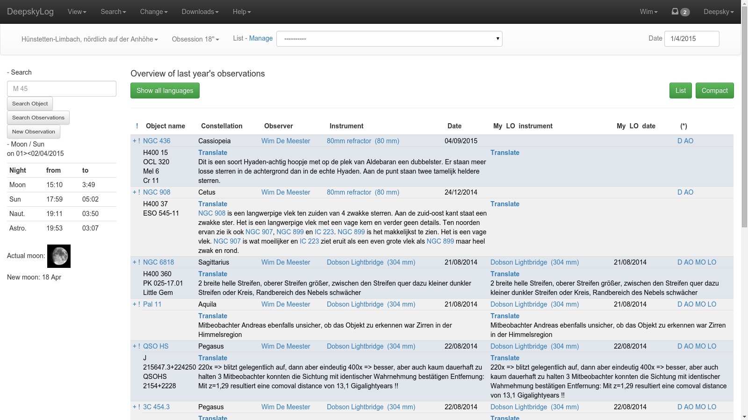

Slide 5
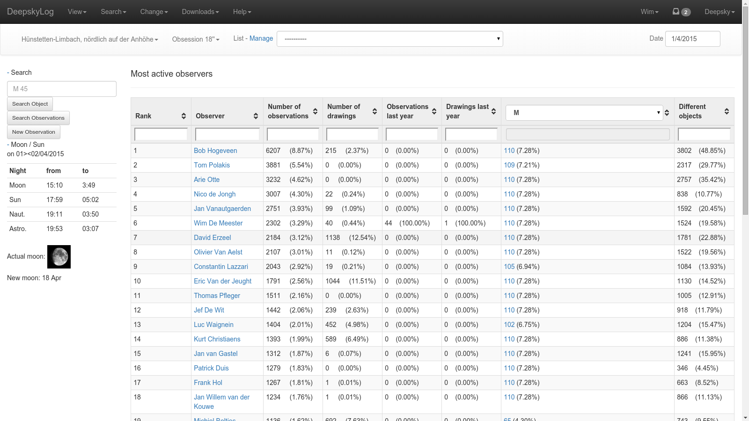

Slide 6
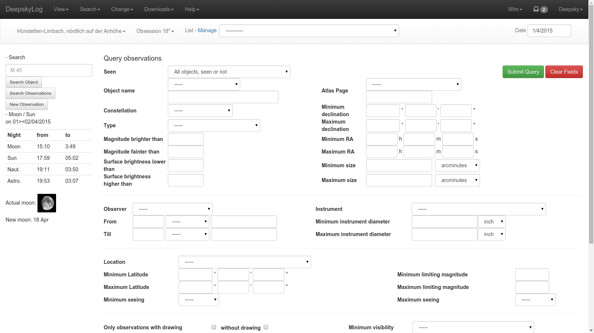

Slide 7
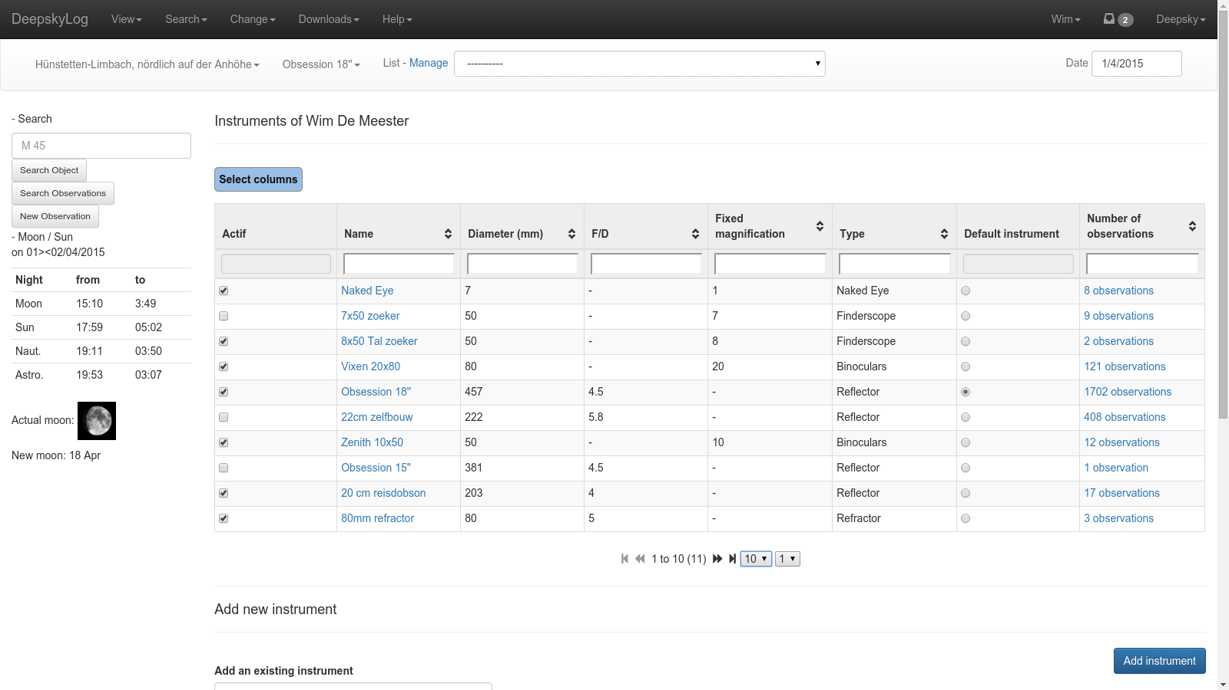

Slide 8
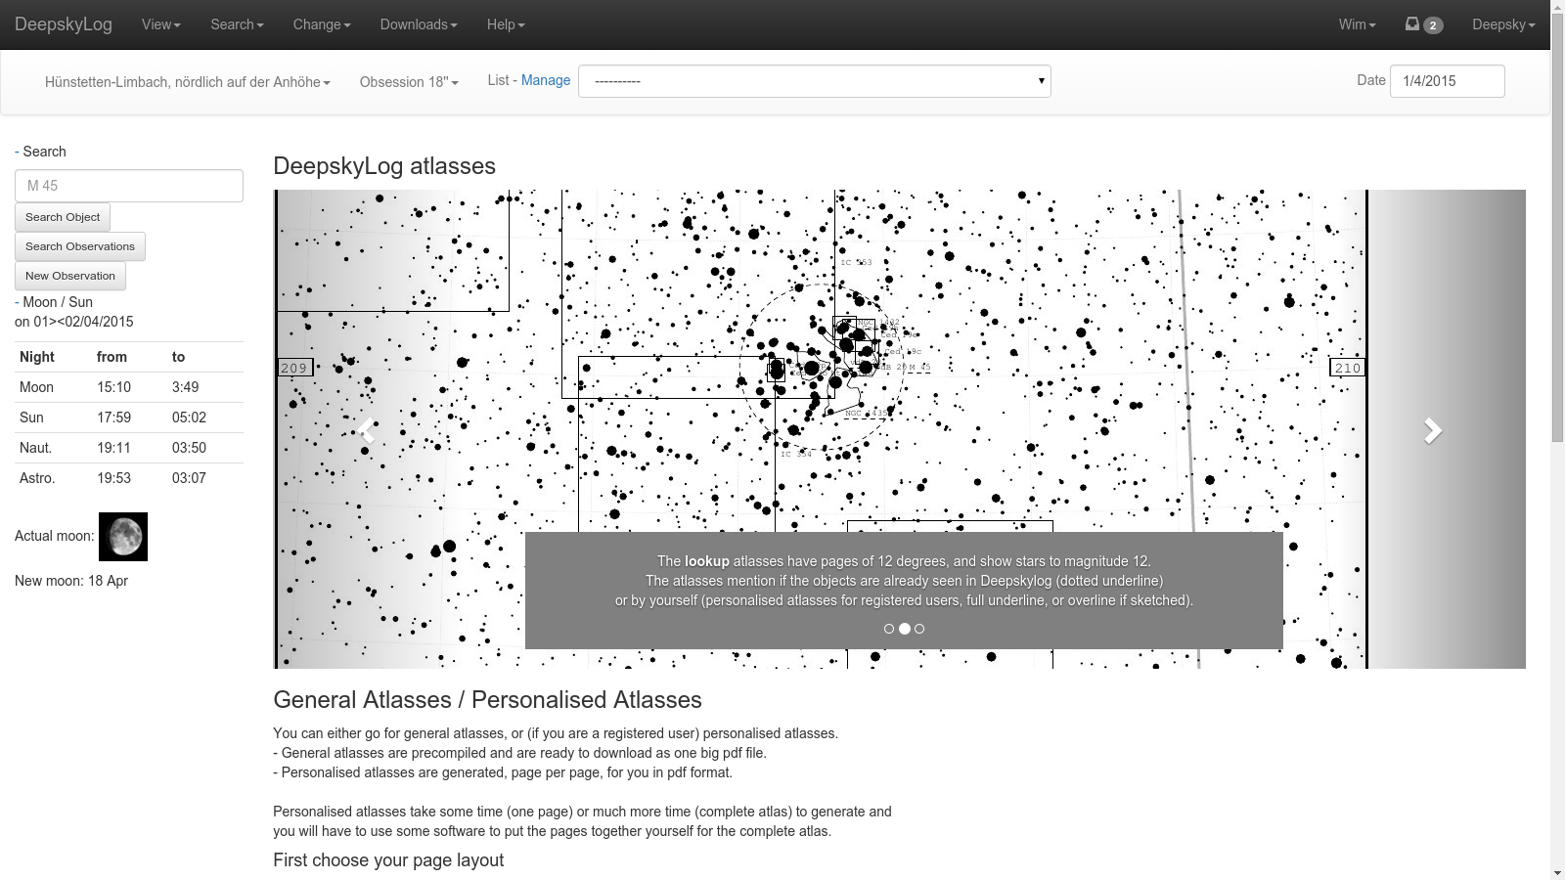

Slide 9
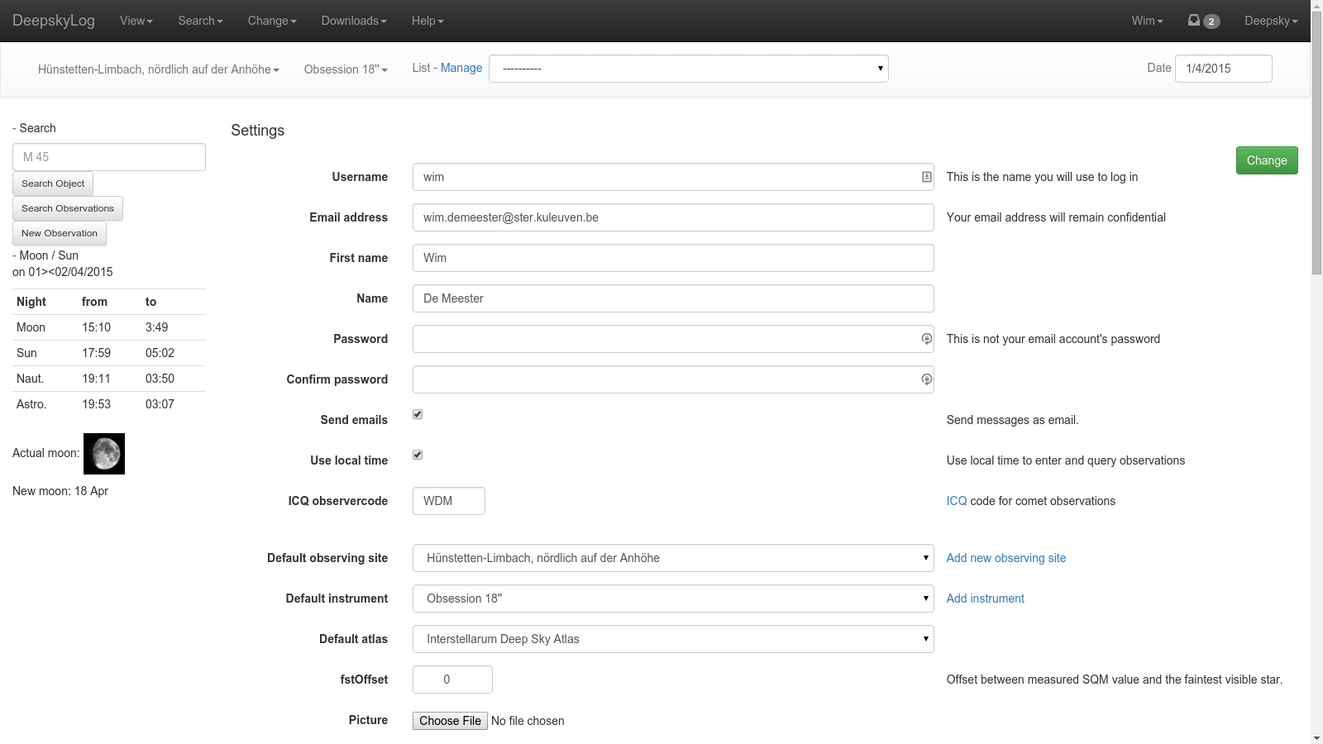

Slide 10
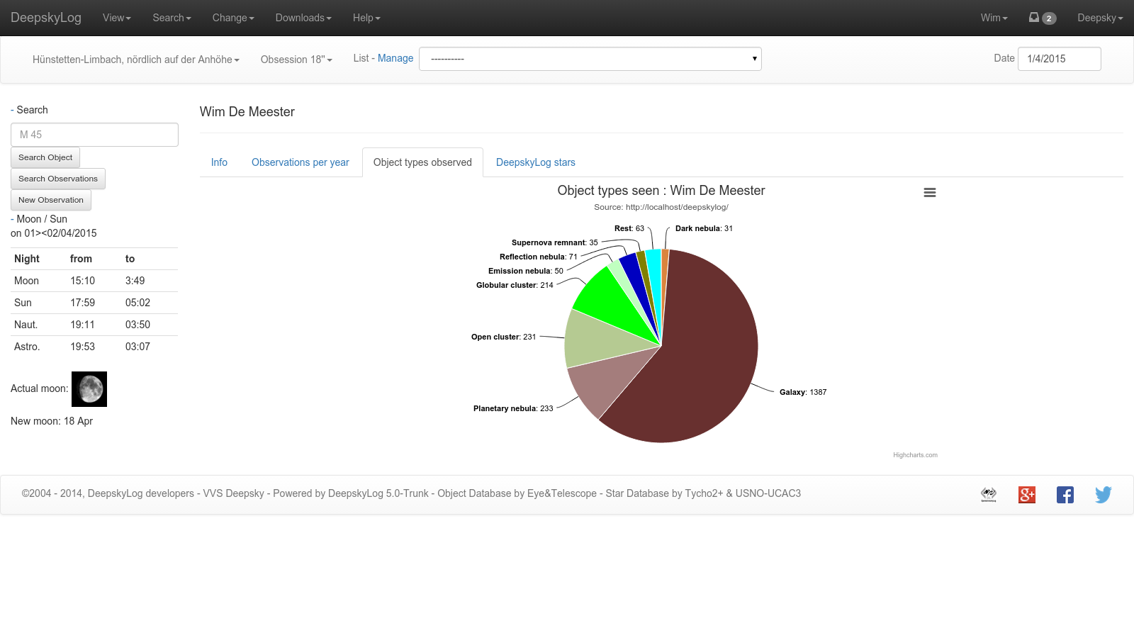

Slide 11
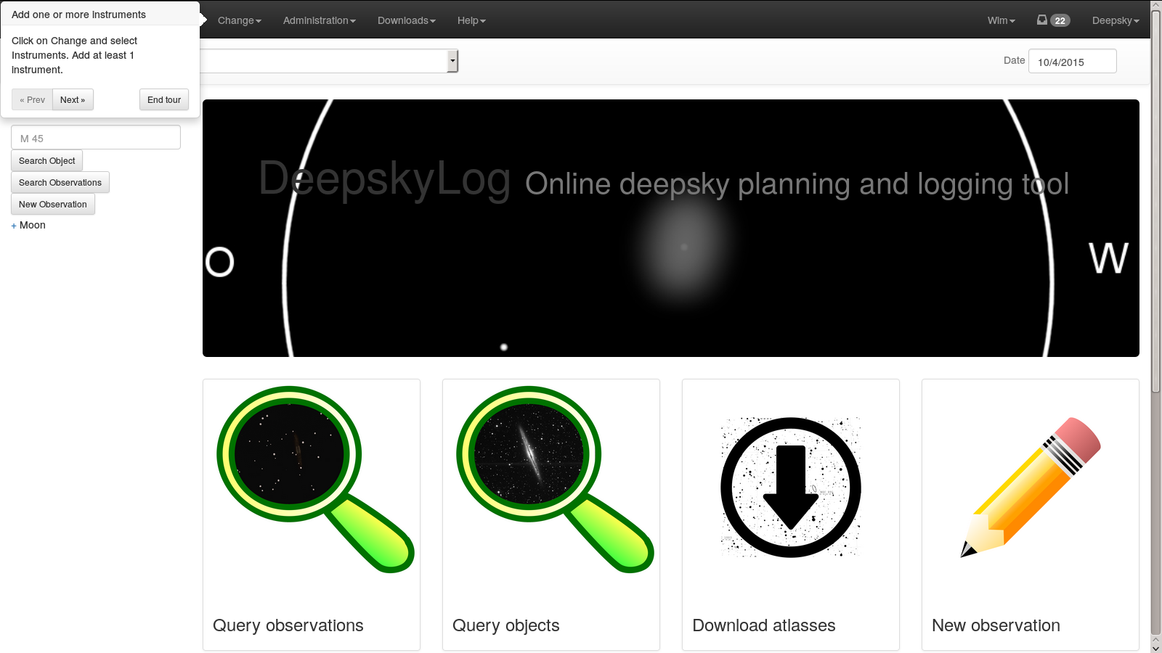

Slide 12
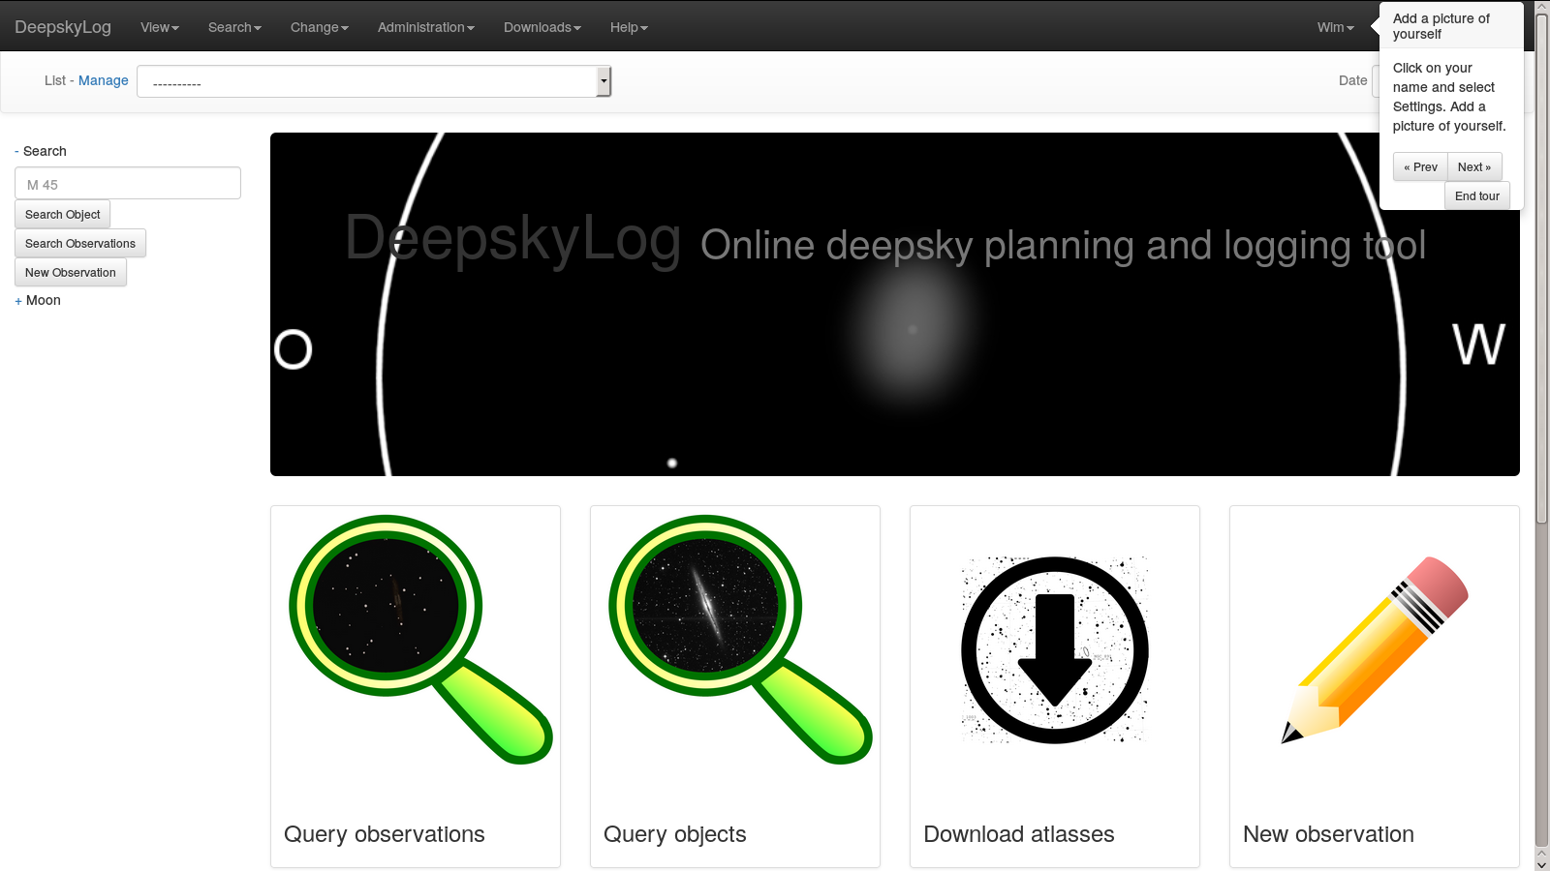

Slide 13
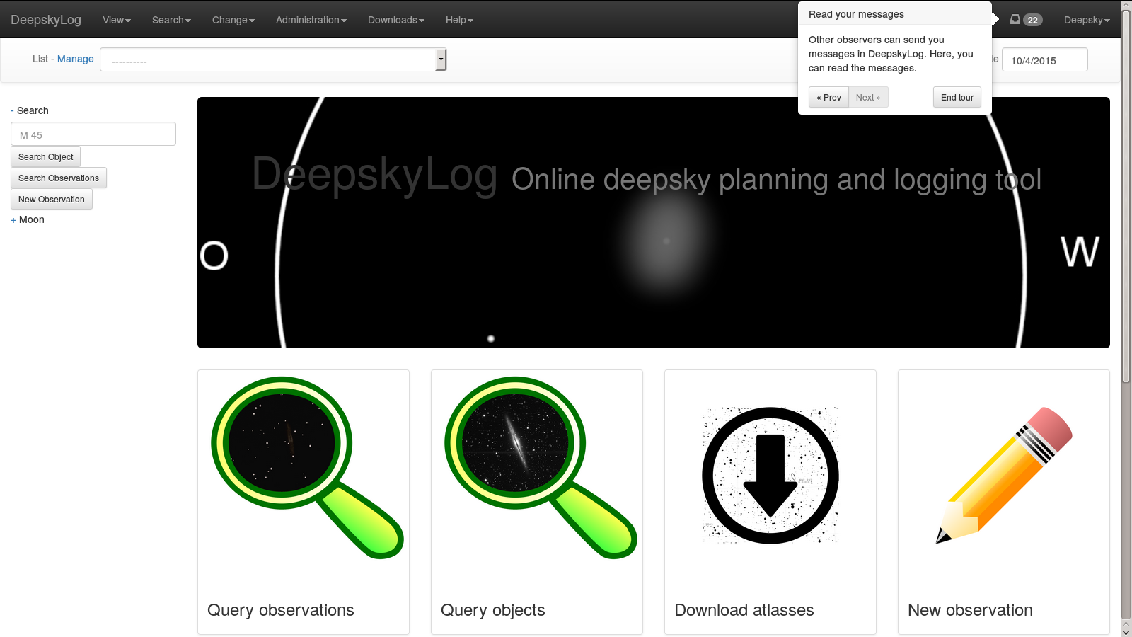

Slide 14
TODO: SCREENSHOT of RESPONSIVE DESIGN

Slide 15
External libraries
jQuery | 1.11.2
jQuery-ui | 1.11.4
Bootstrap | 3.3.2
bootstrap-tour | 0.10.1
tablesorter | 2.18.4
lightbox | 2.7.1
Highcharts | 4.0.4

Slide 16
DeepskyLog Stars
Gamification
Automatic message
Deepsky and comets
Descriptions and drawings

Slide 17
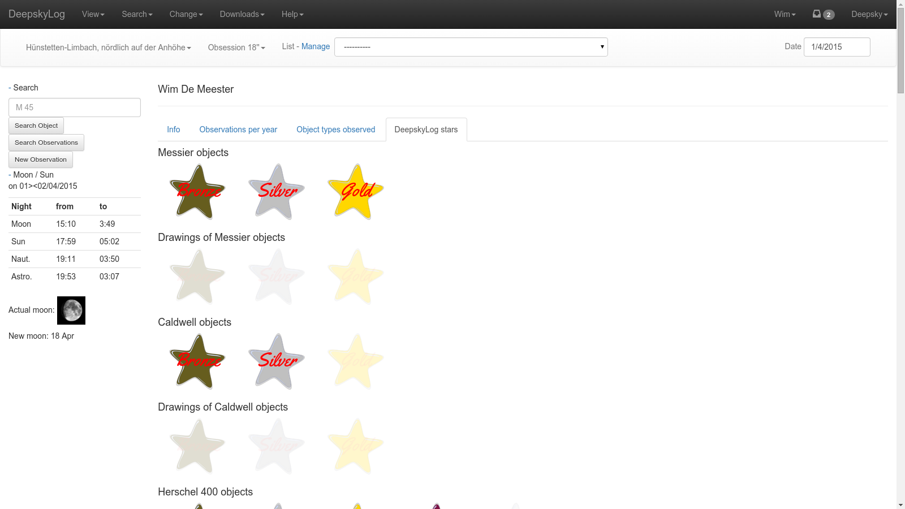

Slide 18
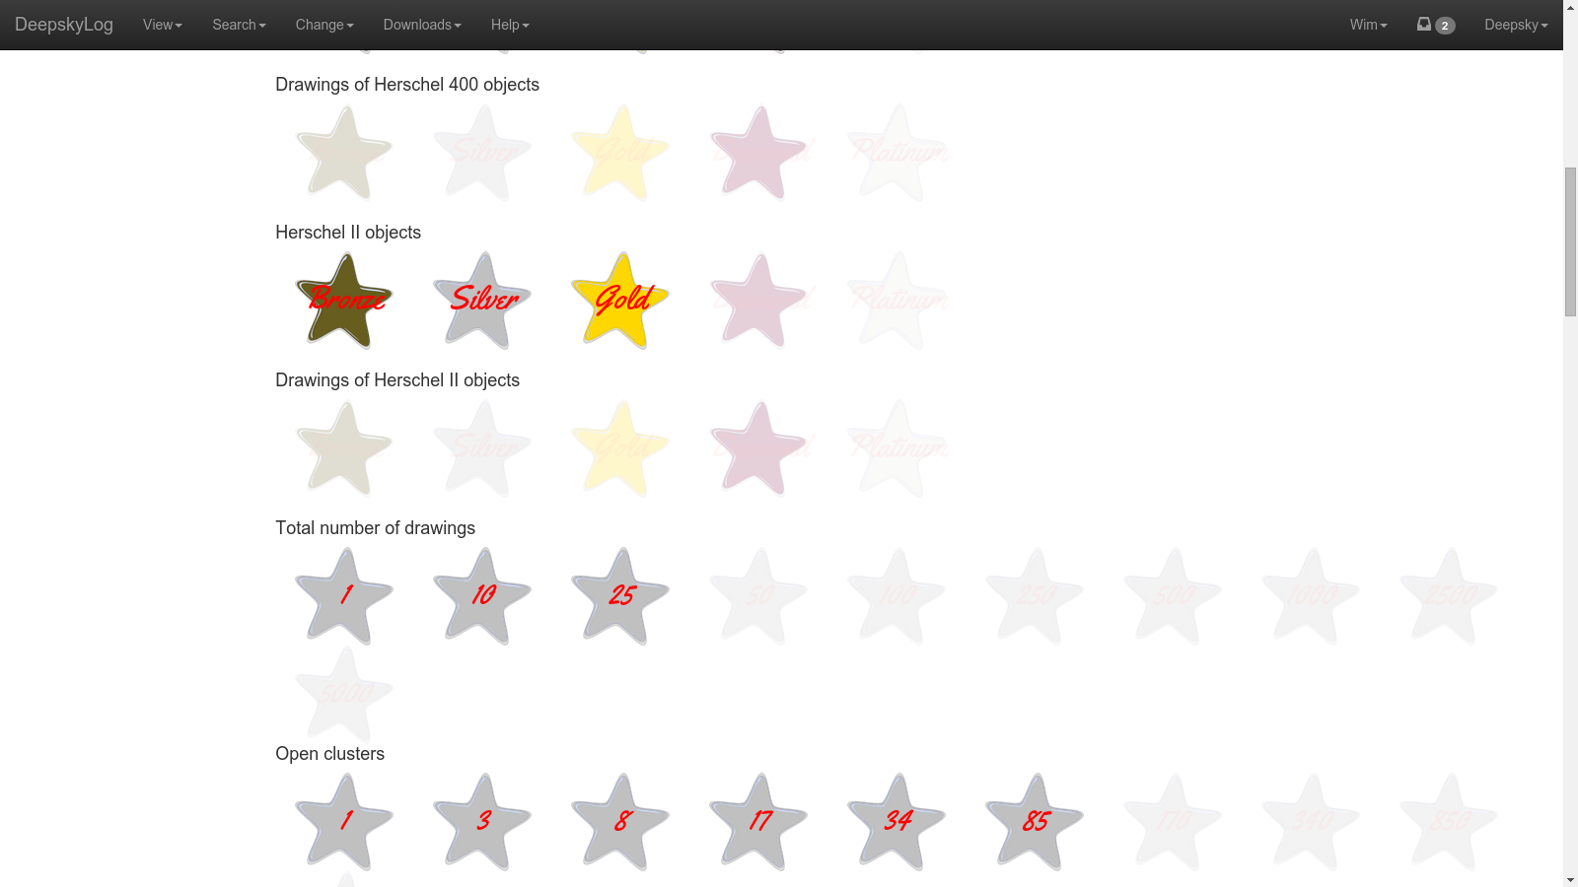

Slide 19
Use real emailaddress
Send message to real email address

Slide 21
Database access
Old mysql methods:
deprecated since php 5.5.
no longer developed since 2006
Migration to PDO_mysql

Slide 22
Picture of observers
In detail of observation.
In messages.

Slide 23
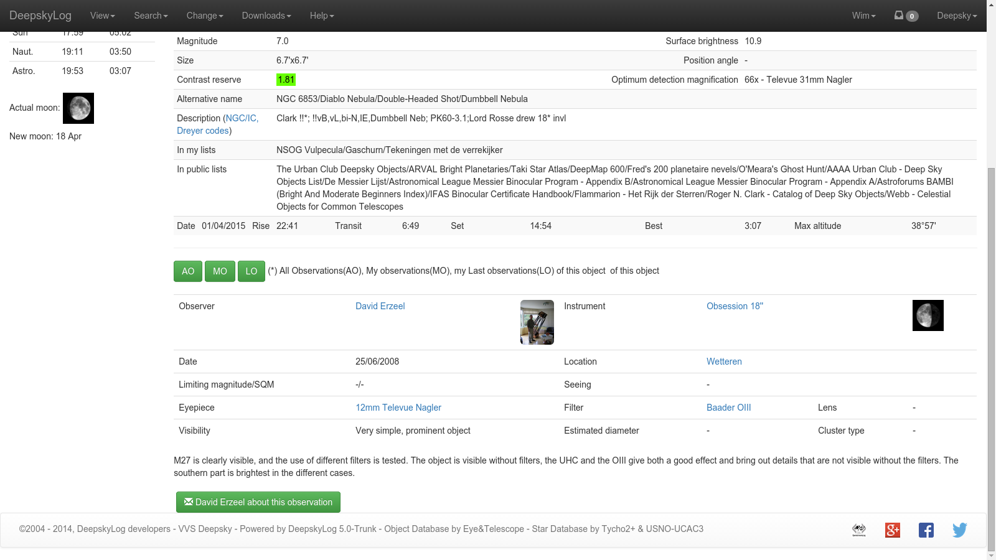

Slide 24
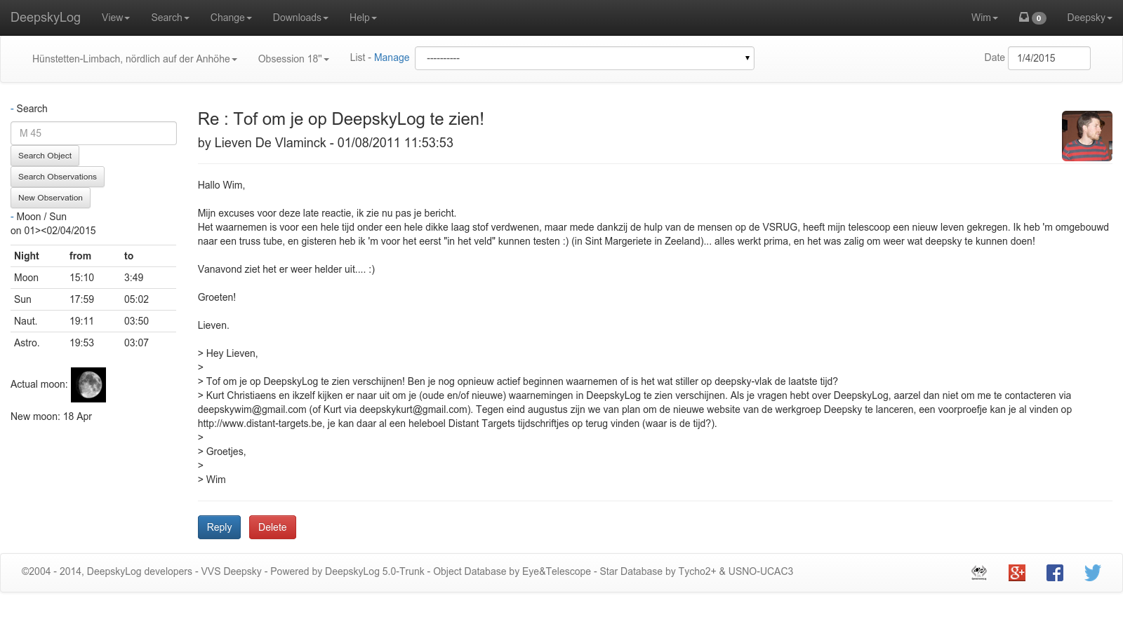

Slide 25
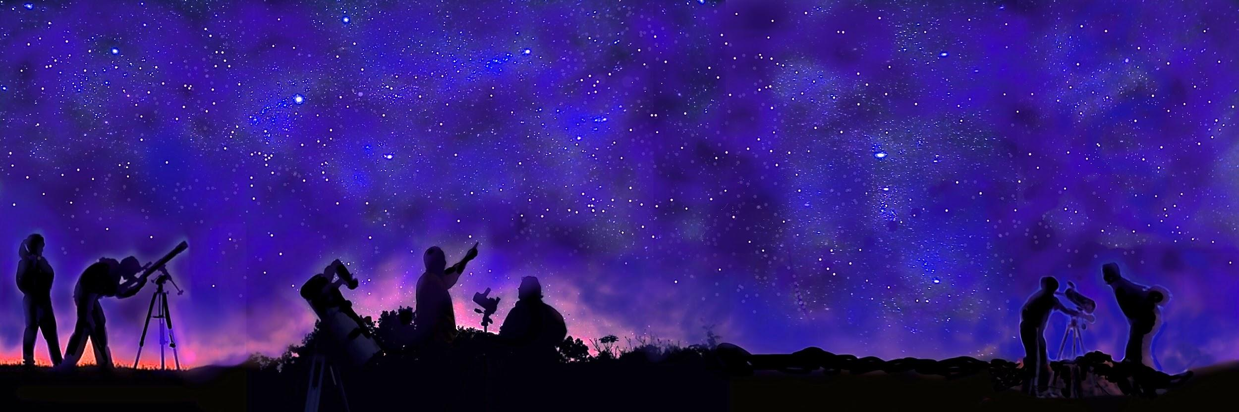
New Logo

Slide 26
New Logo

Slide 27


New Logo

Slide 28
New entry page
Needs new logo

Slide 29
Add locations
Google maps
All your locations are shown on the map.
Update script to
fix wrong locations
fix wrong timezones
add elevation
Don’t show longitude / latitude anymore.
Show weather predictions.

Slide 30
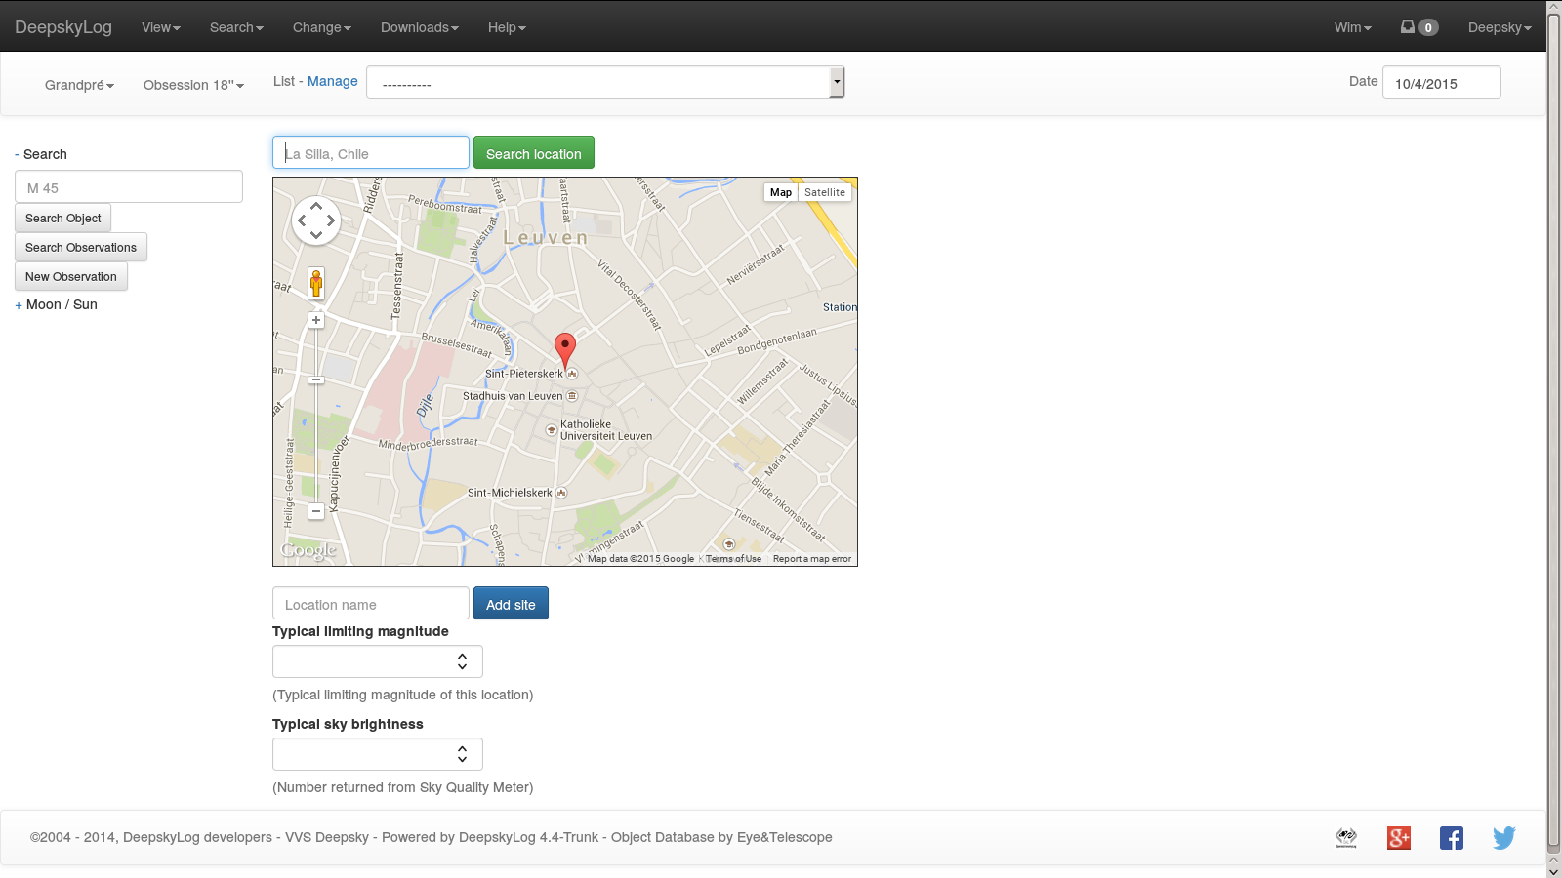

Slide 31
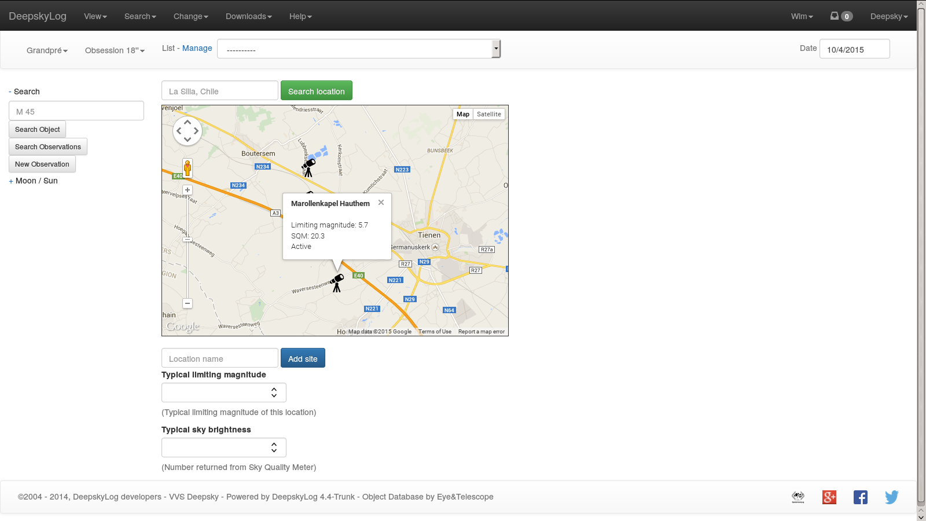

Slide 32
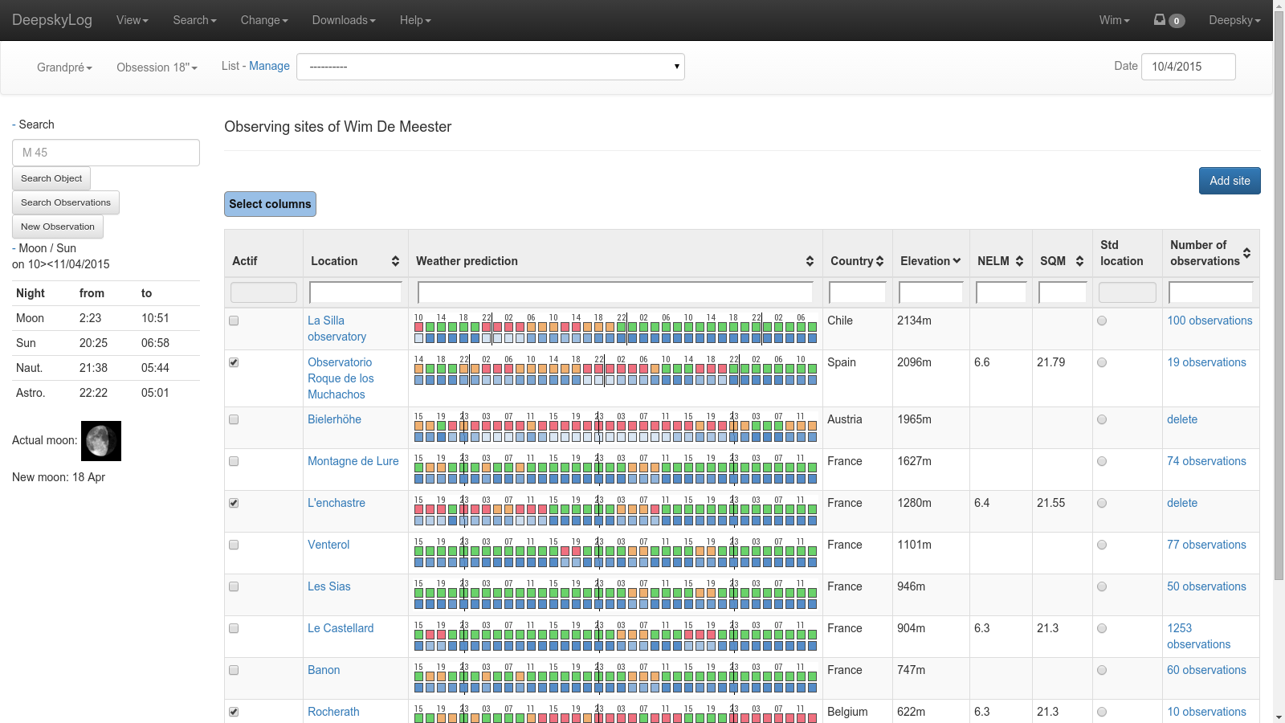

Slide 33
Status deepskylog.se
Person who would help with translation does not respond.
Contact person in Sweden will try to find someone else from the SAAF.
Most persons in Sweden speak English very well.

Slide 34
Questions
Database > 5 gigabyte, mostly in logging table

Slide 35
TODO
Simplify tables
Only show most interesting columns.
Finish new entry page.
Test, test, test!

Slide 36
Input by TC
DeepskyLog is seen by a lot of users as an interface to a database. Should be an easy to use user interface: how?
Downscale start-display of DeepskyLog. Only show relevant information.
Improve quality of data / queries
Filter observations by word count
Shortcuts to frequently used queries

Slide 37
Input by TC
Project to translate DeepskyLog in more languages
Ask current observers to find people to help
Speak to new users / observers
Create short movies for ‘how-to-use DeepskyLog’
Rewrite help section
Survey of users before new release:
What do we want in a new release?

Slide 38
Input by TC
Change Main Menu:
Object data
Observations
My observations
Settings
Help & Startup

Slide 39
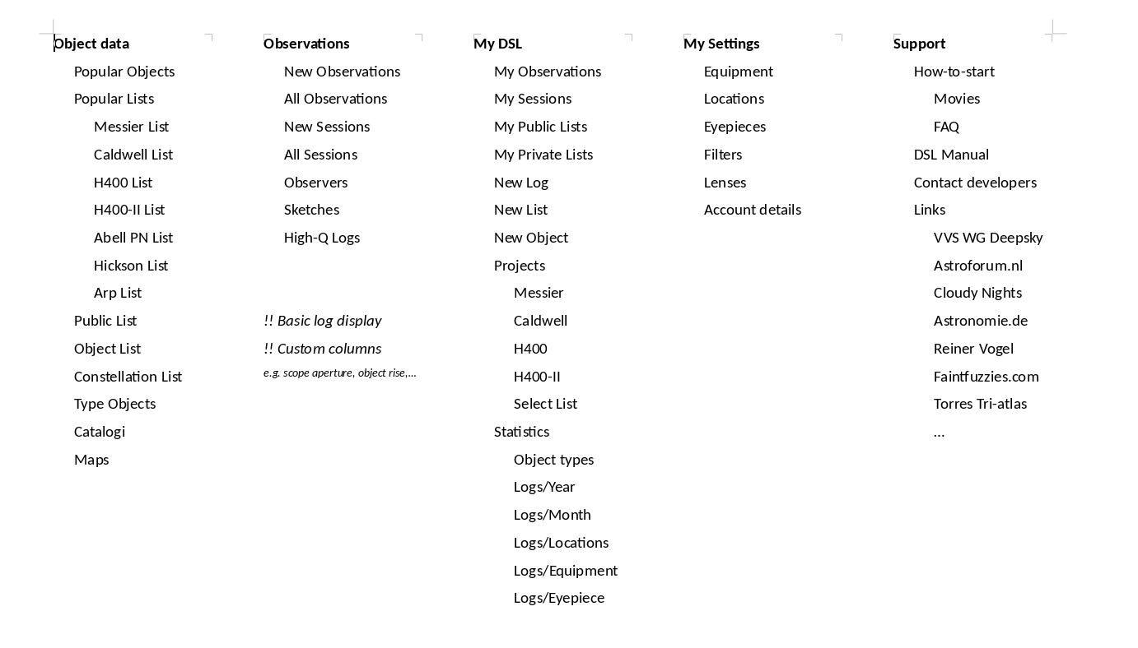

Slide 40
Input by SR
Use black background
List of small corrections / improvements

